Slide 1

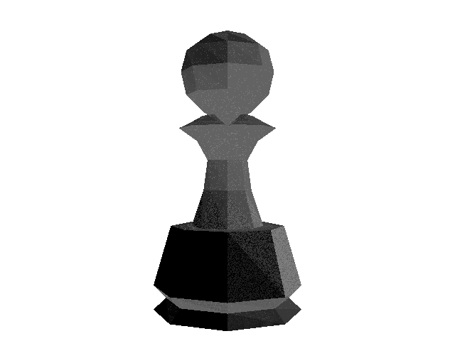
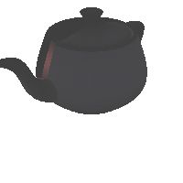
Bringing in objects in scene
12 faces : 2 minutes
400 faces : 21 minutes
1000 faces : 55 minutes

Slide 2
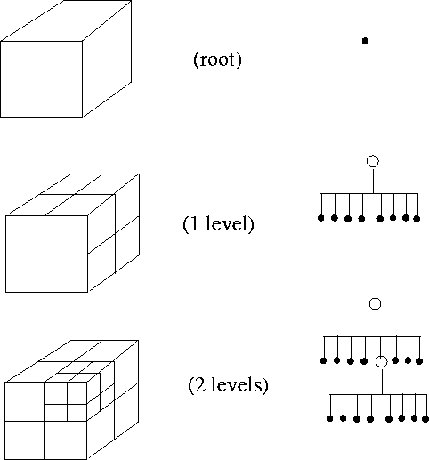
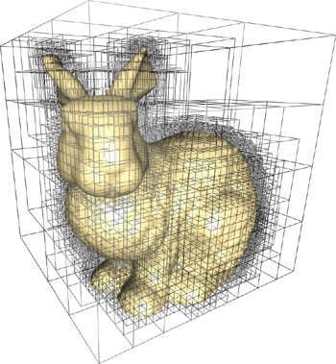
Oct tree optimization

Slide 4
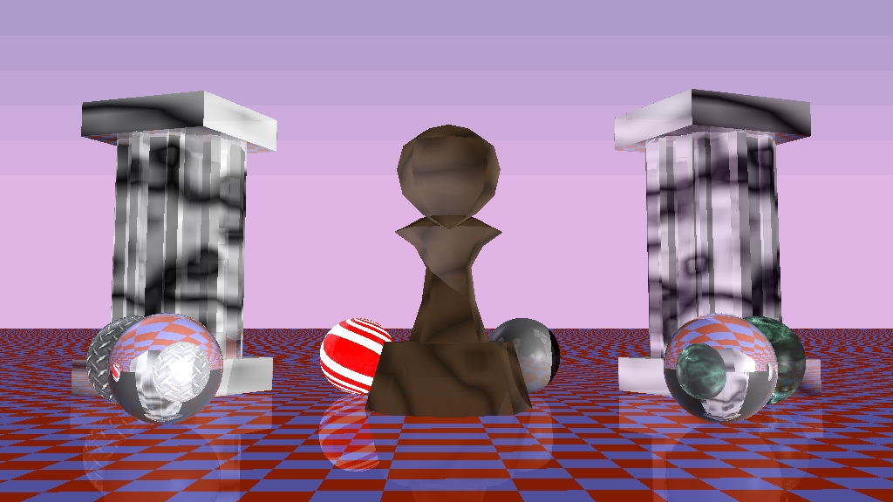
Applying Procedural textures to objects

